Slide 1

Did They Stay or Did They Leave
Ryan Fox

Slide 2
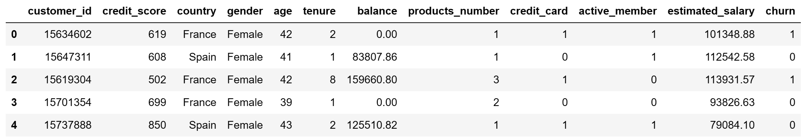
The Data
I found this dataset on Kaggle
Personal interest in Finance and Banking
12 variables and 10,000 samples.
Used to predict bank “Churn”
Cleaned by dropping customer ID, no null values

Slide 3
Data Splits
Test 1: 60/40 – train/test
Test 2: 70/30 – train/test
Test 3: 80/20 – train/test

Slide 4
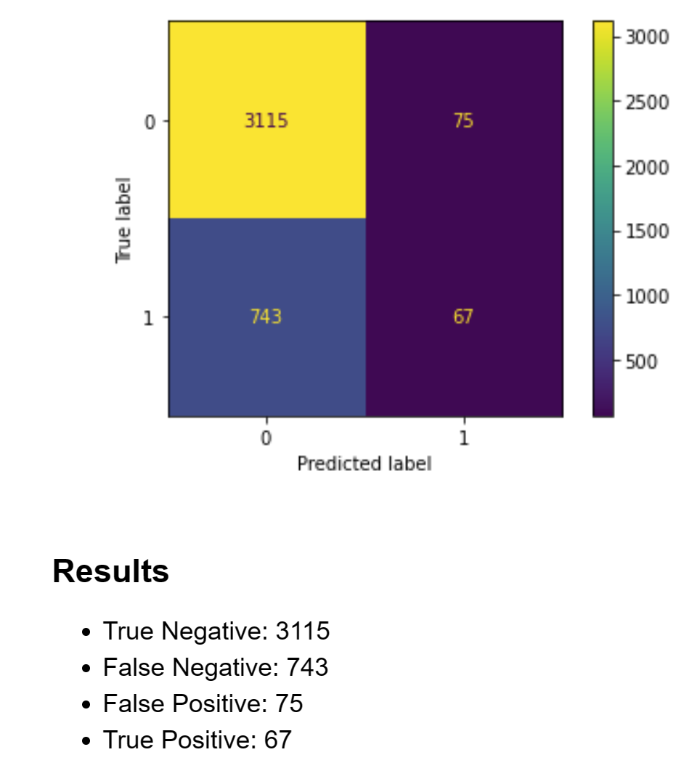
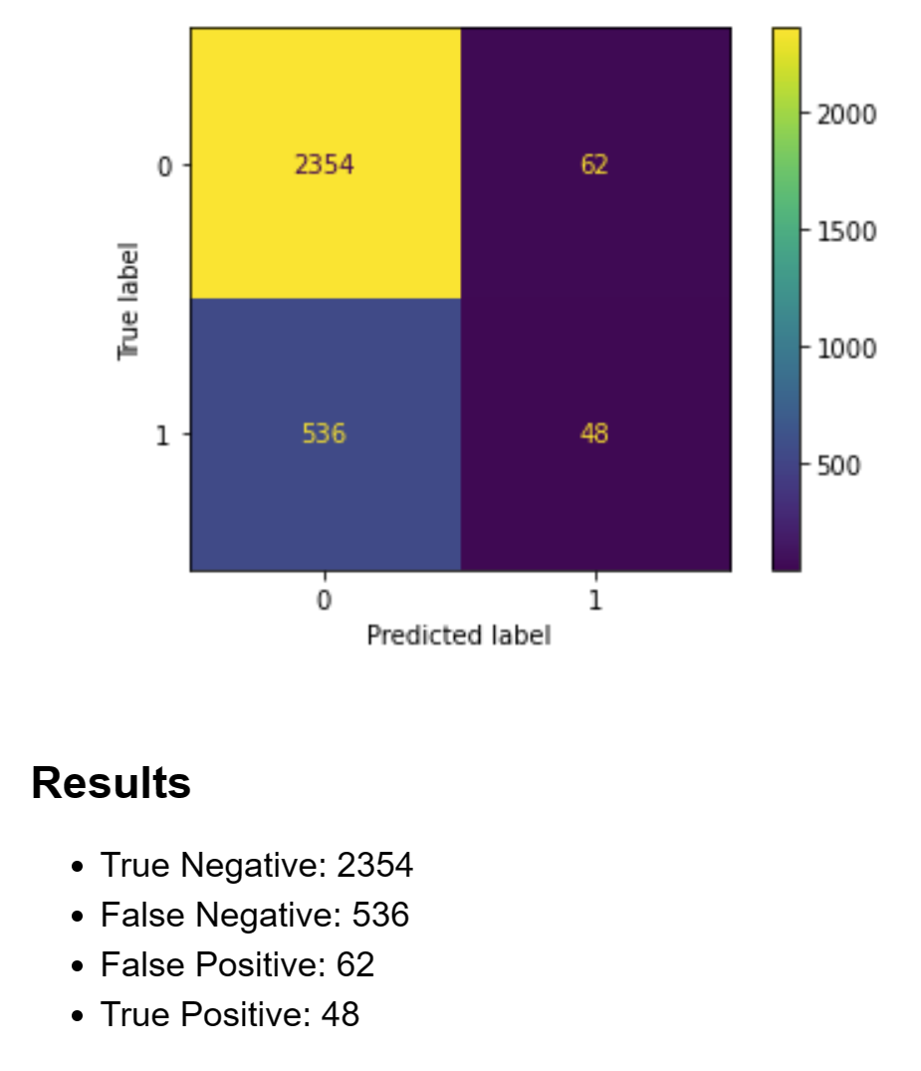
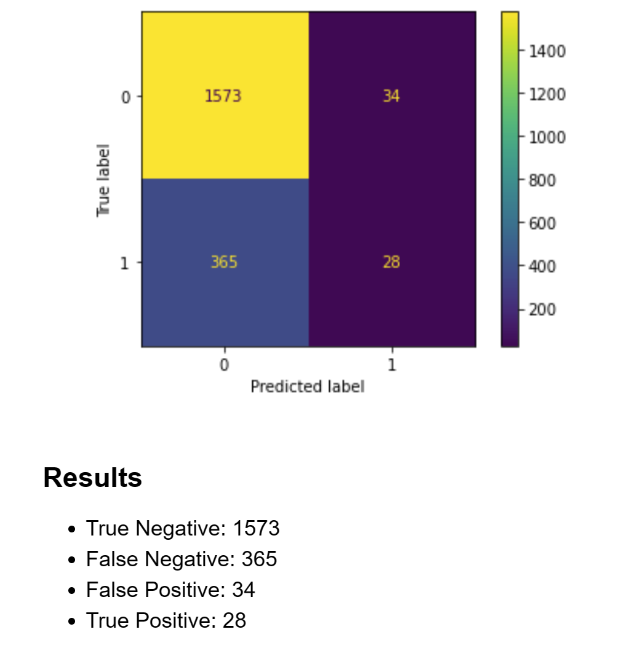
Results

Slide 5

Accuracy
All three models were 80% accurate at predicting bank churn
Large number of false negatives could lead the bank to think they will retain more customers than the actual amount.

Slide 6
Overall
This model had 80% accuracy for predicting bank churn.
This could be improved by using other variables.
This model could be useful for banks today because of the recent global financial strains.

